Slide 1
CAR PRICE PREDICTION
COVER SLIDE
By KUNIGIRI NAGARAJU

Slide 2
Problem Statement
With the covid 19 impact in the market, we have seen lot of changes in the car market.. One of our clients works with small traders, who sell used cars.
Now some cars are in demand hence making them costly and some are not in demand hence cheaper
With the change in market due to covid 19 impact, our client is facing problems with their previous car price valuation machine learning models. So, they are looking for new machine learning models from new data

Slide 3
Now I have analyzed websites for web scrapping the data such as OLX CARDEKHO CARS24 ZIGWHEELS CARTRADE and etc I found CARWALE as best for gathering more cars data
HD

Slide 4
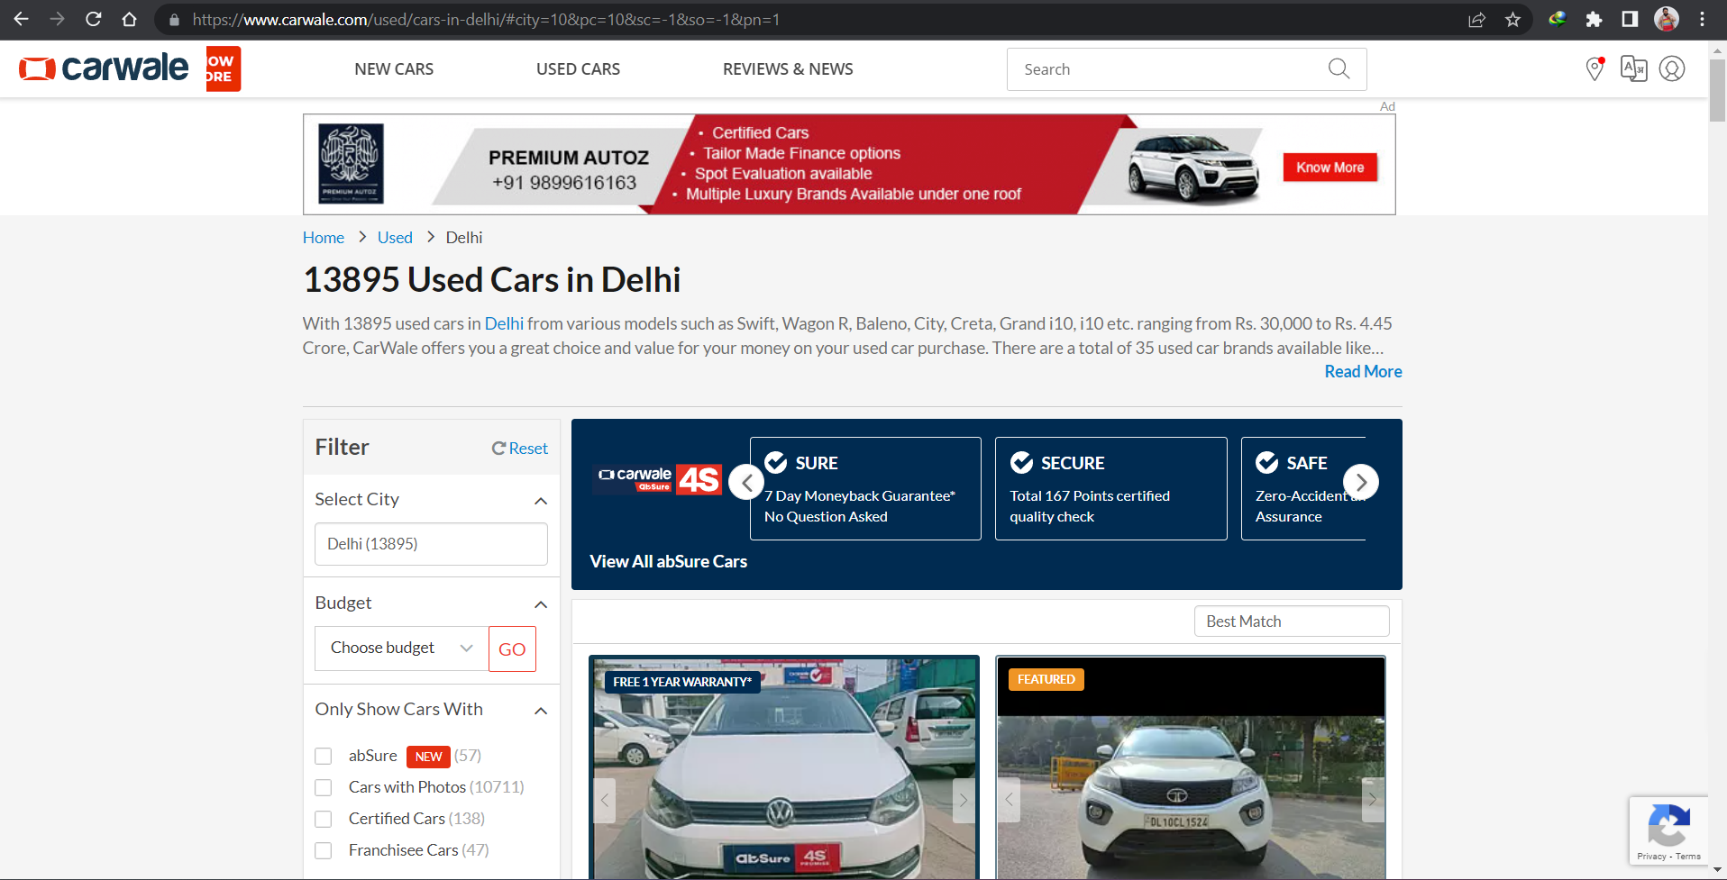
Website is taken into consideration for web scrapping
Get Started for Free

Slide 5
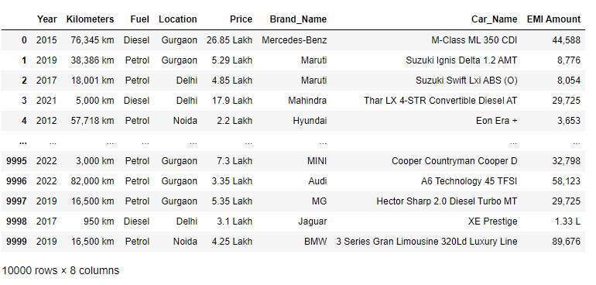
Evolutionary Data Analysis
Dataset after cleaning

Slide 6
Label Features.
Data Description
₀₁
₀₂
₀₃
₀₄
Year
Kilometers
Fuel_Type
Brand_Name
₀₅
₀₆
₀₇
₀₈
Location
E M I
Car_Name
Price

Slide 7
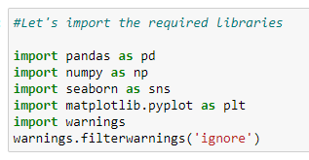
Importing Libraries

Slide 8
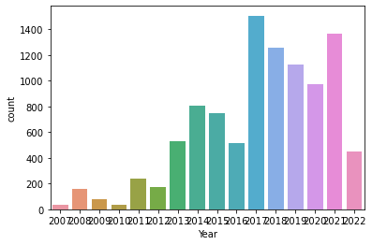
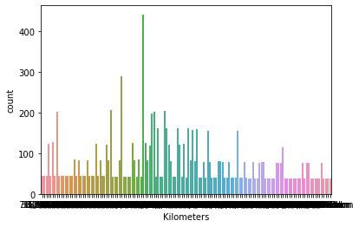
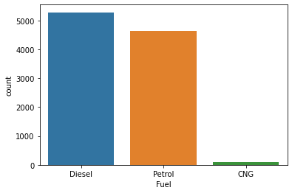
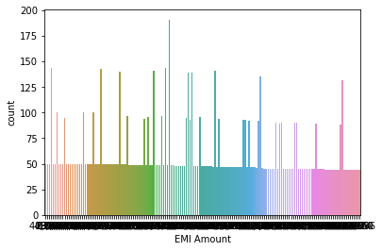
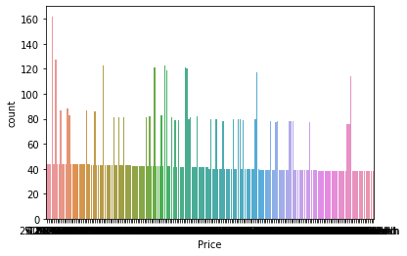
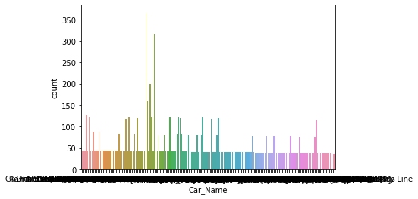
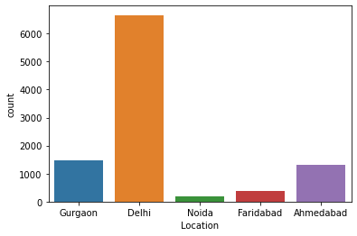
Evolutionary Data Analysis
Importing Libraries

Slide 9
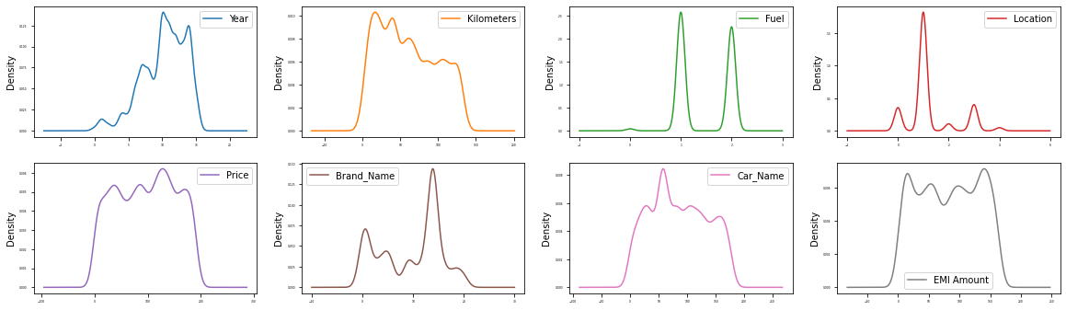
Evolutionary Data Analysis

Slide 10
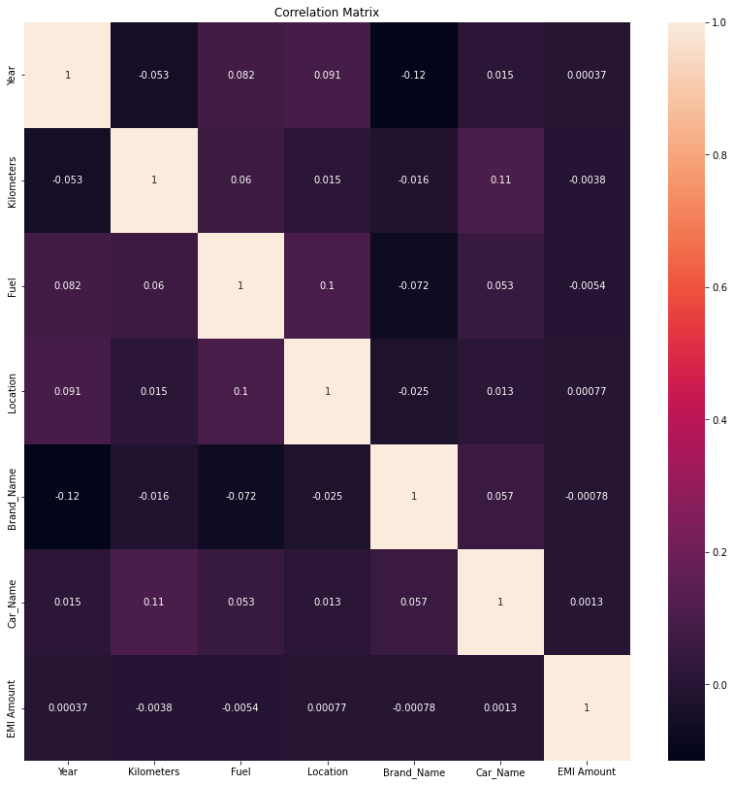
Evolutionary Data Analysis
Correlation Matrix

Slide 11
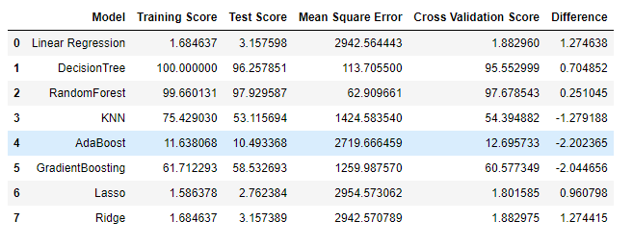
Model Training
We have found Decision Tree and RandomForest have performed well with 100% and 99.6% where RandomForest given decent Cross Validation Score compared to Decision Tree

Slide 12

Model Selecting
After Hypertuning Parameters RandomForestRegressor Performance is slightly incressed with Accuracy of 97% and Cross Validation score 97%

Slide 13
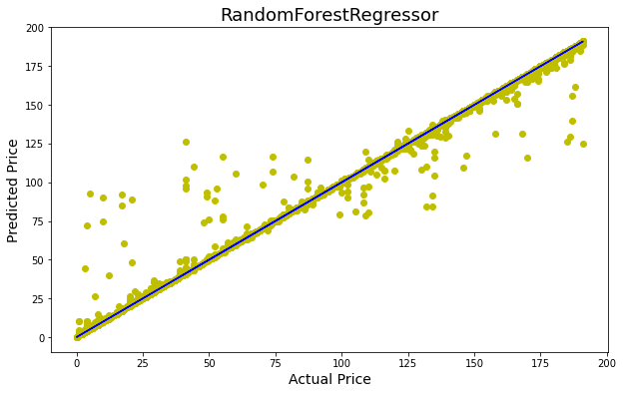
Final Model
RandomForestRegressor model is fitting

Slide 14
Thank you.

